Slide 1
Module 17: X Windows system
17: X Windows system
18: Writing shell scripts

Slide 2
Contents
X
Display managers
X applications
Remote display
Configuring X-apps

Slide 3
X

Slide 4
Text vs. Gui
Historically, systems were text based:
The typical connection was over a serial connection to a text-based terminal.
With the advent of networking, other methods could begin.
This ushered in client/server-based graphics.
This came to be known as X or X Windows.
Until recently the most likely implementation is from X.org.
To improve security and speed a new system without client / server was developed.
This implementation is known as Wayland.
Newer systems use this.
Notes:
X was, historically, always run as a client/server application.
All applications will be X clients, which means that they generate commands that are passed to an X server to display things on the screen, and they accept X messages from the server that describe all input events and where the cursor is.
When an X client wants to draw something on the screen, it makes a network connection (either locally, or over the LAN) to the X Server, which processes the request and draws on the screen.
As the X protocol is independent of Unix/Linux, applications and servers can be run on any combination of operating system.
Thus, a Linux client application could display its output using a server on an, say, Windows machine, and vice-versa.
X Clients can run anywhere; they can run on the same machine the X Server is on, or they can run across town; the only requirement is that there be a reasonably fast network connection between the host running the X Server and the client.
This is now considered bad for security, and of course slow on systems with built-in graphics, so a non client/server implementation has now replaced x.org this is known as Wayland.

Slide 5
x.org tools
The traditional tool was xvidtune.
This eventually became replaced by tools such as gtf, cvt, and xrandr.
$ gtf 1920 1080 60
[...] Modeline "1920x1080_60.00" 172.80 1920 2040 2248 2576 1080 1081
1084 1118 -HSync +Vsync
$ xrandr | grep connected
eDP-1 connected primary 1920x1080+0+0 (normal left inv right x axis y axis)
293mm x 165mm
HDMI-1 disconnected (normal left inverted right x axis y axis)
$ cvt 1920 1080 60
[...] Modeline "1920x1080_60.00" 173.00 1920 2048 2248 2576 1080 1083
1084 1118 -hSync +vsync
Notes:
In early Linux installations, one had to configure X manually. Although this is no longer an issue, configuring the card to match the monitor can still be troublesome.
Number of additional, helper tools exist to assist you in interrogating current setting, and to diagnose and fix any display problems.
xrandr is one of the most useful Xorg tools. It is a set of libraries that help in detecting and configuring the screens.
It is powerful in exploring the available settings as well as adding and implementing new modes.
It’s often used to fine-tune configuration of dual-monitors.
xrandr can also be used to set the size, orientation and/or reflection of the outputs for a screen.
An associate tools, gtf (for calculating VESA modelines) and cvt (for calculating VESA Coordinated Video Timing modelines).

Slide 6
Display managers

Slide 7
What is a display manager?
X (x.org) is a client-server (network) application.
It did not support resizable, moveable, overlapping windows.
Or minimizing / maximizing.
To enable this, display managers were written.
They use the XDMCP protocol.
X display managers include:
XDM - basic, original X display manager.
KDM - KDE display manager.
GDM – GNOME display manager.
Notes:
Linux is renowned for its richness of choices.
Each Linux uses a program that manages graphical display servers and handles graphical user logins.
Popular display managers are based on Gnome or KDE, often providing additional “shell” on top of them.

Slide 8
Switching display managers
Virtual terminals (CLI terminals) are available on function keys:
<F1> – <F7>
X Windows (GUI) is associated with one of these, varying with system and sometimes version.
In older systems, pre-systemd, GUI can be restarted with <Ctrl>+<Alt>+<Backspace>.
Since RHEL 7, Ubuntu 17.10, and SUSE 12, GUI is a service managed by systemctl.
To switch between text and graphics:
$ sudo systemctl restart gdm.service
$ sudo systemctl restart lightdm.service
$ sudo systemctl restart display-manager.service
$ sudo systemctl isolate multi-user.target
$ sudo systemctl isolate graphical.target

Slide 9
X applications

Slide 10
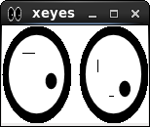

Running X applications
X applications may be started from menus.
Or, invoked from shell prompt, usually in background.
$ xeyes &
[2] 5015
$ xclock &
[1] 4496

Slide 11

Screenshots
X provides a simple screen capture facility.
Use xwd to capture an image and write it to disk:
It can be used to write directly to a printer.
To create a snapshot:
Run the command, specifying the destination.
Click on the window you want captured.
You can view the saved image with xwud tool.
$ xwd -out clock-img.xwd
OR
$ xwd > clock-img.xwd
$ xwud -in clock-img.xwd
OR
$ xwud < clock-img.xwd
Notes:
The xwd tool must be the simplest and oldest screenshot utility available, provided in 1985, with one of the the early X Window System releases.
xwd can take a simple snapshot, which can be subsequently viewed.

Slide 12
Controlling X
Many tools exist to configure X and manipulate windows applications.
Example of remapping mouse buttons, to make the mouse suitable for left-handed operation:
To swap the meaning of button 1 and 3, using the xmodmap utility:
Tool | Use
xwininfo | Window display information
xprop | Display detail for font or window
xrdb | X resource database management
xmodmap | To modify keymaps and pointer button mappings
$ xmodmap -e 'pointer = 3 2 1 4 5'
[...]

Slide 13
Remote display

Slide 14
Displaying on other machines (x.org only)
Use xhost to control remote access to your display:
Consider other access control methods and techniques:
MAC configuration of SELinux or AppArmour
Firewall rules (firewalld and/or iptables)
Xorg parameters (port listening, XDMPC)
Any additional (e.g., xauth) settings
Desktop manager's (gdm, kde, lxde, etc.) setting and configuration
$ xhost +
access control disabled, clients can connect from any host
$ xhost +yogi
You are being added to access control list
Notes:
Normally, we start an X application to be displayed on the screen in front of you. If you are using x.org,, you may choose to display the application on a different machine, which - perhaps - has better graphics capabilities(*).
For this to work a number of access-control settings, which must be initiated by a user on the machine with the X server, that specifies which machines can access that server.
First of all, your firewall needs to open the relevant ports (in the 6000 range). You need to start the Xorg server with -listen tcp option, to explicitly enable port 6000 listening. Your distribution may facilitate this by allowing the -listen tcp as parameter used at run time, or through a configuration file.
Finally, run the host tool - use plus and a list of machine names to add them to the list of machines that are allowed access, and use minus to remove them from the list. Use xhost with no arguments to see the current settings.

Slide 15
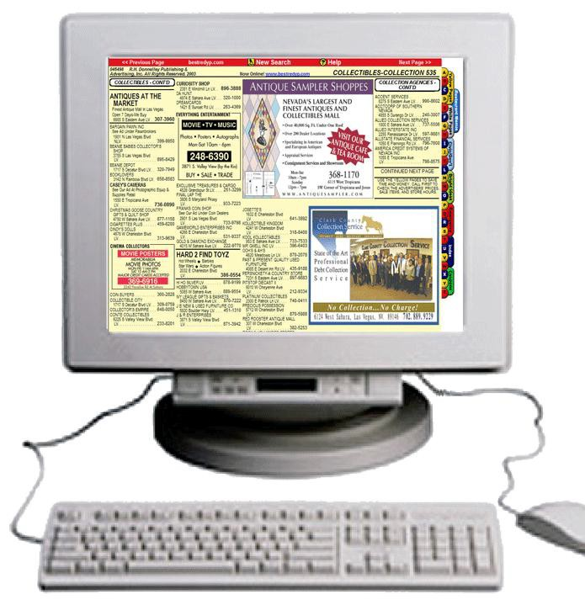












Specifying other machines displays (x.org only)
Using local and remote hosts to display X applications
For this session only, or permanently
1
$ xapp &
$ xapp -display booboo:0 &
$ DISPLAY=yogi:0; export DISPLAY
$ xapp &
$
2
$
$
$
$
$
3
$ xapp &
$ xapp -
$ DISPLAY
$ xapp &
$
xapp &
xapp -display booboo:0 &
DISPLAY=yogi:0; export DISPLAY xapp &
display booboo:0 &
=yogi:0; export DISPLAY
m1
m2
m3
1
$ xclock &
will display locally
2
$ xclock –display m2:0 &
will display on m2
3
$ export DISPLAY=m3:0
$ xclock &
will always display on m3
Notes:
Display names have three parts:
Firstly, the hostname or the IP address.
Then the display number: 0 unless the machine has more than one display /keyboard combination. Finally, the screen number (optional), for machines where one keyboard controls more than one screen.
In the examples above:
- run xclock on the local screen (this is the default behaviour)
- run xclock on the main screen of host m2; display definition applies to this command only
- run xclock on the main screen of host m3; DISPLAY definition applies to all X commands
Executed subsequently (in this session).
To permanently display your X applications on a remote host, you may set (and export the DISPLAY variable, with its value pointing at the host and the X server on that host to use. Place the definition in your start-up file (~/.bash_profile or ~/.basrhrc), for your own use, or in the /etc/profile - to be applied to every user on your machine.

Slide 16
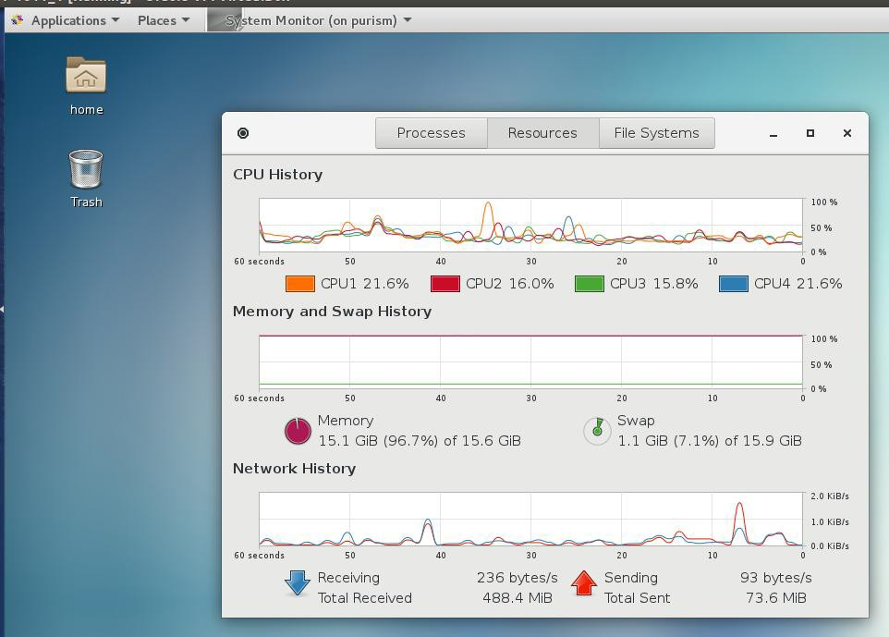
GUI apps across machines: More securely
X data tunneled inside a secure ssh packet
$ ssh –X remoteuser@remotemachine /usr/bin/gnome-system-manager
Notes:
The ssh command is better known as a secure replacement for all other remote login programs (such as telnet, or rlogin).
The same ssh can also be used for the purpose of forwarding X programs over the network (the -X option).
This allows any X program to be displayed on a remote host securely, as ssh will encrypt all data being forwarded.
In the example above, the gnome-system-monitor program is being processed on the remote host, but it is being displayed on the local machine.

Slide 17
Configuring X-apps

Slide 18
Resources
X applications are highly configurable.
Aspects of appearance and behavior are controlled through resources.
Examples of resources:
Colors
Fonts
Initial position and size
Behavior in response to certain events
Resources can be set in different ways:
From the command line
From special configuration files
Many systems allow basic resources to be examined and set
Notes:
Application designers prepare programs to have a certain pre-defined look and feel.
A number of those settings can, however, be modified to suit your requirement or taste.
These settings are referred to as resources and include most of screen and window drawing attributes.

Slide 19
Resource management
Inside the X system is a resource manager.
Holds configuration information passed to X applications
System-wide definitions are in Xdefaults or Xresources
Users may have their own resources.
In either .Xdefaults or .Xresources file in their home directory
KDE and GNOME may have their own configuration.
Global resource definition repository in /etc/X11 or /opt
New definitions can be written to resource manager
$ xrdb –query #to view current resource settings
...
$ xrdb Xdefaults
Notes:
The X server pick the resources from the pre-defined locations. These are the Xdefaults and Xresources
files, stored under the /etc/X11 directory.
Users, if they so choose may add to (or modify) system defaults, by creating equivalent 'dot' files in their home directory.
Using xrdb -merge can then be applied to add the customised resources to the global database. Properties will be added to the existing ones and lexicographically sorted.
The xrdb (X server resource database utility) command can be used for both viewing currently used resources, and to rebuild the database after changes (or if you want to add additional resource file).

Slide 20
Fonts
X supports a large range of fonts.
Use xlsfonts to list fonts available on your system.
Many apps have a switch to specify font:
$ xlsfonts | more
-adobe-utopia-bold-i-normal--0-0-0-0-p-0-iso8859-1
[...]
$ xedit -fontname courier &
Notes:
There are literally thousands of fonts available to Linux programmers. Unfortunately, there is no guarantee that the fonts the developers chose to use are available on your system.
The xlsfonts command allows you to check the installed fonts. If you are trying to confirm if any particular font exists, you could pipe the output of xlsfonts to grep:
$ xlsfonts | grep console
-misc-console-medium-r-normal--0-0-72-72-c-0-iso10646-1
…
Most of the time, you will require a fixed-spaced font. Choose a font in which the fourth-from-last field in the long font name is either ‘c’ or ‘m’.
A proportionally-spaced font, that has ‘p’ in the same field will look very strange when viewing any tabulated output.
‘fixed’ in the second field is also a good indication of fixed-width fonts, although some fixed-width fonts do not contain this.
Alias names for fonts are defined in the file fonts.alias in the directories containing the fonts. Use ‘xset -q’ to see which directories are in the font path.

Slide 21
Colours
Many aspects of an application’s colors can be set.
Foreground, background, text color
X uses RGB model for specifying color, composed of different intensities of: Red Green Blue
To display an RGB color-name database:
stored in either:
/etc/X11/rgb.txt
or /usr/share/X11/rgb.txt
$ xterm -fg gold –bg blue &
$ showrgb | grep olive
128 128 0
Notes:
Every X application uses a common set of definitions relating to the handling of GUI objects. The available
fonts and colour definitions are fundamental examples of such resources.
Other definitions may include features like size of the new window, the position of a new window in a display, text that will appear in the title bar, etc.
Some applications may be configured to start with or without a scroll bar on the side, and so on...

Slide 22
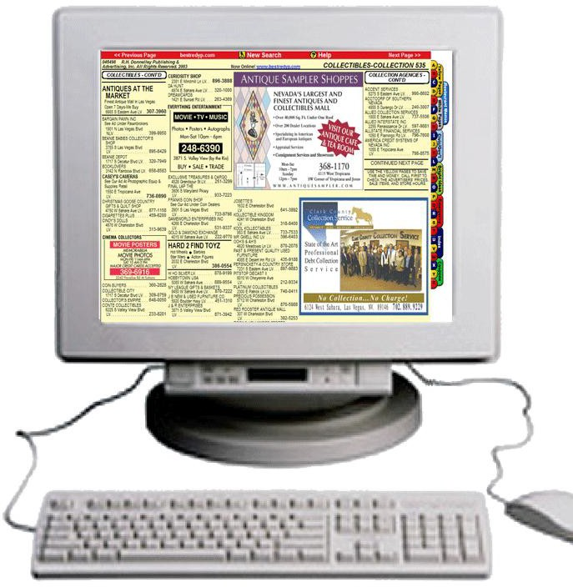


Geometry
You can specify an application's size and location on screen.
These can be changed afterwards using window manager.
Resource specification syntax:
Width x Height ± Xoffset ± Yoffset
Offsets in pixels from corners of the display
+ + - +
+ - - -
$ xterm -g '80x24+0+0' &
$ xterm -geometry '80x24' &
$ xclock -g '700x500-0-0' &
$ xclock -geometry '+50-50' &
Notes:
The position of a window on the screen can be manipulated by the geometry options.
Practical application for this may be placement of an application on one corner of the screen, to ensure that it doesn't obstruct another window.
Notice that both -geometry, and the single letter option, -g, are equally effective.
Omitting the "Width and Height" or the "Offsets" will give a default value that is application specific.

Slide 23
Review and lab

Slide 24
Review questions
What is the name of the graphics software used by Linux?
Which option is used to request X client to display red text?
What is the difference between XDMCP and XDM?
On your machine, what command would you have to type to display all your subsequent X applications on another machine (X.org)?
How would you run graphics apps from a remote machine so that they would display onto your local machine (wayland)?
Notes:
It is called X, until recently the main implementation was X.org, this is being superseded by Wayland.
The colour of text is controlled by the –foreground (or –fg) option.
XDMCP stands for X Desktop Management Control Protocol – it's a network protocol that facilitates client-server X logons. XDM is one of the desktop manager programs, building on XDMCP abilities.
$ export DISPLAY=”linux1:0.0”
You would tunnel X over ssh.

Slide 25
Practical exercise 17
In the accompanying Exercise Guide

Slide 26
Summary
The X Window System allows Linux to operate in a GUI environment.
The X.org X Window System was a client-server application.
On the whole supplanted by Wayland
On x.org use xhost command to set display access rights.
Use -display option or DISPLAY variable to define where application is to be displayed
There are numerous window managers available.
GNOME, KDE, and more
X applications allow manipulation of attributes.
Referred to as resources: fonts, colors, geometry

